Slide 1
2
Main Ideas
Notes:
See page 55 in textbook

Slide 2
CHAPTER 2 Main Ideas
What Is the Main Idea?
What Is the Main Idea?
“What’s the point?”
You’ve probably heard these words before. It’s a question people ask when they want to know the main idea that someone is trying to express.
The same question can guide you as you read.
Recognizing the main idea, or point, is
the most important key to good comprehension.
Notes:
See page 55 in textbook

Slide 3
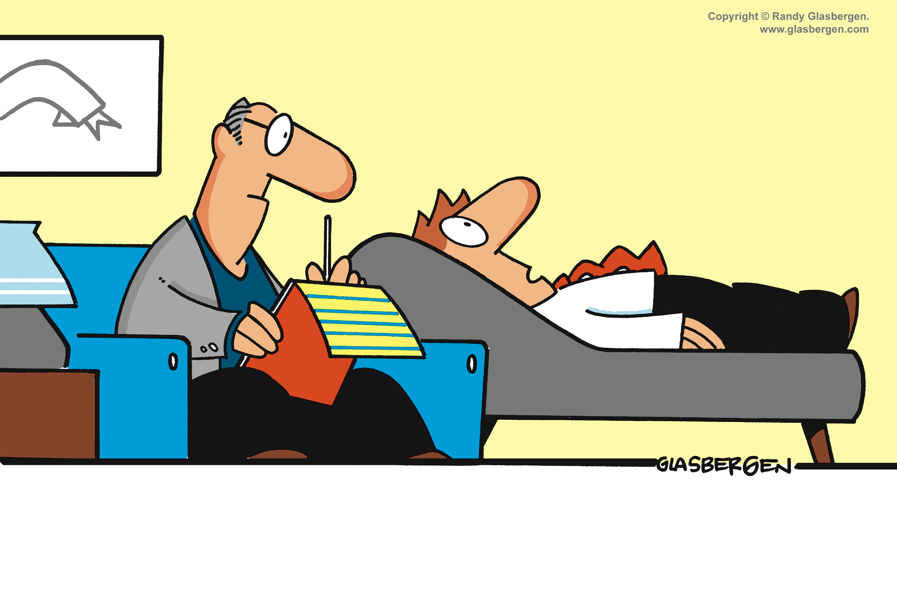
CHAPTER 2 Main Ideas
What Is the Main Idea?
Sometimes a main idea is immediately clear, as in the cartoon below. What would you say is the speaker’s point in the cartoon?
The point is that the man on the couch has problems.
The point is supported by his statements about his job, wife, friends, and dog.
Main idea
1
2
3
4
Notes:
See page 55 in textbook
ANSWER: The man on the couch has problems.

Slide 4
CHAPTER 2 Main Ideas
What Is the Main Idea?
To find the main idea of a reading selection,
ask yourself:
“What’s the point the author is trying to make?”
Notes:
See page 55 in textbook

Slide 5
CHAPTER 2 Main Ideas
What Is the Main Idea?
Read this paragraph, asking yourself, “What is the author’s point?”
Many people feel that violence on television is harmless entertainment. However, we now know that TV violence does affect people in negative ways. One study showed that frequent TV watchers are more fearful and suspicious of others. They try to protect
themselves from the outside world with extra locks on the doors, alarm systems, guard dogs, and guns. In addition, that same study showed that heavy TV watchers are less upset about real-life violence than non-TV watchers. It seems that the constant violence they see on TV makes them less sensitive to the real thing. Another study, of a group of children, found that TV violence increases aggressive behavior. Children who watched violent shows were more willing to hurt another child in games where they were given a choice between helping and hurting. They were also more likely to select toy weapons over other kinds of playthings.
Notes:
See page 56 in textbook

Slide 6
CHAPTER 2 Main Ideas
What Is the Main Idea?
Many people feel that violence on television is harmless entertainment. However, we now know that TV violence does affect people in negative ways. One study showed that frequent TV watchers are more fearful and suspicious of others. They try to protect
themselves from the outside world with extra locks on the doors, alarm systems, guard dogs, and guns. In addition, that same study showed that heavy TV watchers are less upset about real-life violence than non-TV watchers. It seems that the constant violence they see on TV makes them less sensitive to the real thing. Another study, of a group of children, found that TV violence increases aggressive behavior. Children who watched violent shows were more willing to hurt another child in games where they were given a choice between helping and hurting. They were also more likely to select toy weapons over other kinds of playthings.
A good way to find an author’s point, or main idea, is to look for a general statement.
Then decide if that statement is supported by most of the other material in the paragraph.
Notes:
See page 56 in textbook

Slide 7
CHAPTER 2 Main Ideas
What Is the Main Idea?
Below the paragraph are four statements from the passage. Pick out the general statement that is supported by the other material in the passage.
Many people feel that violence on television is harmless entertainment. However, we now know that TV violence does affect people in negative ways. One study showed that frequent TV watchers are more fearful and suspicious of others. They try to protect
themselves from the outside world with extra locks on the doors, alarm systems, guard dogs, and guns. In addition, that same study showed that heavy TV watchers are less upset about real-life violence than non-TV watchers. It seems that the constant violence they see on TV makes them less sensitive to the real thing. Another study, of a group of children, found that TV violence increases aggressive behavior. Children who watched violent shows were more willing to hurt another child in games where they were given a choice between helping and hurting. They were also more likely to select toy weapons over other kinds of playthings.
A. Many people feel that violence on television is harmless entertainment.
B. However, we now know that TV violence does affect people in negative ways.
C. One study showed that frequent TV watchers are more fearful and suspicious of others.
D. They try to protect themselves from the outside world with extra locks on the doors, alarm systems, guard dogs, and guns.
Notes:
See page 56 in textbook
ANSWER: B
The next slide shows and explains the answer.

Slide 8
CHAPTER 2 Main Ideas
What Is the Main Idea?
Many people feel that violence on television is harmless entertainment. However, we now know that TV violence does affect people in negative ways. One study showed that frequent TV watchers are more fearful and suspicious of others. They try to protect
themselves from the outside world with extra locks on the doors, alarm systems, guard dogs, and guns. In addition, that same study showed that heavy TV watchers are less upset about real-life violence than non-TV watchers. It seems that the constant violence they see on TV makes them less sensitive to the real thing. Another study, of a group of children, found that TV violence increases aggressive behavior. Children who watched violent shows were more willing to hurt another child in games where they were given a choice between helping and hurting. They were also more likely to select toy weapons over other kinds of playthings.
A. Many people feel that violence on television is harmless entertainment.
The paragraph does not support the idea that TV violence is harmless, so sentence A cannot be the main idea. However, it does introduce the topic
of the paragraph: TV violence.
Notes:
See page 56 in textbook

Slide 9
CHAPTER 2 Main Ideas
What Is the Main Idea?
Many people feel that violence on television is harmless entertainment. However, we now know that TV violence does affect people in negative ways. One study showed that frequent TV watchers are more fearful and suspicious of others. They try to protect
themselves from the outside world with extra locks on the doors, alarm systems, guard dogs, and guns. In addition, that same study showed that heavy TV watchers are less upset about real-life violence than non-TV watchers. It seems that the constant violence they see on TV makes them less sensitive to the real thing. Another study, of a group of children, found that TV violence increases aggressive behavior. Children who watched violent shows were more willing to hurt another child in games where they were given a choice between helping and hurting. They were also more likely to select toy weapons over other kinds of playthings.
C. One study showed that frequent TV watchers are more fearful and suspicious of others.
This sentence is about only one study. It is not general enough to include the other studies that are also cited in the paragraph. It is the first supporting idea for the main idea.
Notes:
See page 56 in textbook

Slide 10
CHAPTER 2 Main Ideas
What Is the Main Idea?
Many people feel that violence on television is harmless entertainment. However, we now know that TV violence does affect people in negative ways. One study showed that frequent TV watchers are more fearful and suspicious of others. They try to protect
themselves from the outside world with extra locks on the doors, alarm systems, guard dogs, and guns. In addition, that same study showed that heavy TV watchers are less upset about real-life violence than non-TV watchers. It seems that the constant violence they see on TV makes them less sensitive to the real thing. Another study, of a group of children, found that TV violence increases aggressive behavior. Children who watched violent shows were more willing to hurt another child in games where they were given a choice between helping and hurting. They were also more likely to select toy weapons over other kinds of playthings.
This sentence provides detailed evidence for the first supporting idea, which is that frequent TV watchers are more fearful and suspicious of others. It does not cover
the other material in the paragraph.
D. They try to protect themselves from the outside world with extra locks on the doors, alarm systems, guard dogs, and guns.
Notes:
See page 56–57 in textbook

Slide 11
CHAPTER 2 Main Ideas
What Is the Main Idea?
Many people feel that violence on television is harmless entertainment. However, we now know that TV violence does affect people in negative ways. One study showed that frequent TV watchers are more fearful and suspicious of others. They try to protect
themselves from the outside world with extra locks on the doors, alarm systems, guard dogs, and guns. In addition, that same study showed that heavy TV watchers are less upset about real-life violence than non-TV watchers. It seems that the constant violence they see on TV makes them less sensitive to the real thing. Another study, of a group of children, found that TV violence increases aggressive behavior. Children who watched violent shows were more willing to hurt another child in games where they were given a choice between helping and hurting. They were also more likely to select toy weapons over other kinds of playthings.
B. However, we now know that TV violence does affect people in negative ways.
The statement “TV violence does affect people in negative ways” is a general one. And the rest of the passage goes on to describe three negative ways that TV violence affects people. Sentence B, then, is the sentence that expresses the main idea of the passage.
Notes:
See page 56 in textbook

Slide 12
CHAPTER 2 Main Ideas
What Is the Main Idea?
Many people feel that violence on television is harmless entertainment. However, we now know that TV violence does affect people in negative ways. One study showed that frequent TV watchers are more fearful and suspicious of others. They try to protect
themselves from the outside world with extra locks on the doors, alarm systems, guard dogs, and guns. In addition, that same study showed that heavy TV watchers are less upset about real-life violence than non-TV watchers. It seems that the constant violence they see on TV makes them less sensitive to the real thing. Another study, of a group of children, found that TV violence increases aggressive behavior. Children who watched violent shows were more willing to hurt another child in games where they were given a choice between helping and hurting. They were also more likely to select toy weapons over other kinds of playthings.
TV watchers are more fearful and suspicious
TV watchers are less upset about
real-life violence
TV violence increases aggressive behavior
B. However, we now know that TV violence does affect people in negative ways.
B. However, we now know that TV violence does affect people in negative ways.
The statement “TV violence does affect people in negative ways” is a general one. And the rest of the passage goes on to describe three negative ways that TV violence affects people. Sentence B, then, is the sentence that expresses the main idea of the passage.
Notes:
See page 56 in textbook

Slide 13
CHAPTER 2 Main Ideas
What Is the Main Idea?
Many people feel that violence on television is harmless entertainment. However, we now know that TV violence does affect people in negative ways. One study showed that frequent TV watchers are more fearful and suspicious of others. They try to protect
themselves from the outside world with extra locks on the doors, alarm systems, guard dogs, and guns. In addition, that same study showed that heavy TV watchers are less upset about real-life violence than non-TV watchers. It seems that the constant violence they see on TV makes them less sensitive to the real thing. Another study, of a group of children, found that TV violence increases aggressive behavior. Children who watched violent shows were more willing to hurt another child in games where they were given a choice between helping and hurting. They were also more likely to select toy weapons over other kinds of playthings.
Notes:
See page 56 in textbook

Slide 14
CHAPTER 2 Main Ideas
What Is the Main Idea?
The Main Idea as an “Umbrella” Idea
Think of the main idea as an “umbrella” idea. The main idea is the author’s general point.
Notes:
See page 57 in textbook

Slide 15
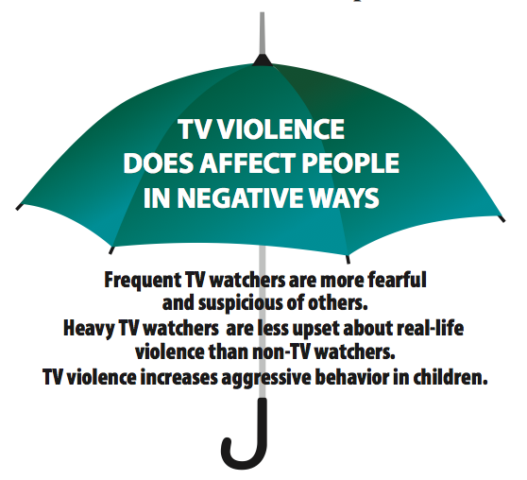
CHAPTER 2 Main Ideas
What Is the Main Idea?
/ The Main Idea as an “Umbrella” Idea
Think of the main idea as an “umbrella” idea. The main idea is the author’s general point.
Notes:
See page 57 in textbook

Slide 16
CHAPTER 2 Main Ideas
What Is the Main Idea?
/ The Main Idea as an “Umbrella” Idea
Think of the main idea as an “umbrella” idea. The main idea is the author’s general point.
The other material of the paragraph fits under the main idea.
Notes:
See page 57 in textbook

Slide 17
CHAPTER 2 Main Ideas
What Is the Main Idea?
/ The Main Idea as an “Umbrella” Idea
The other material of the paragraph fits under the main idea. That other material is made up of specific supporting details—evidence such as examples, reasons, or facts.
Notes:
See page 57 in textbook

Slide 18
CHAPTER 2 Main Ideas
Recognizing a Main Idea
As you read through a passage, you must think as you read.
If you merely take in words, you will come to the end of the passage without understanding much of what you have read.
You must actively engage your mind, and, as you read, keep asking yourself, “What’s the point?”
Notes:
See page 57 in textbook

Slide 19
CHAPTER 2 Main Ideas
Recognizing the Main Idea
Here are three strategies that will help you find the main idea:
1 Look for general versus specific ideas.
2 Use the topic to lead you to the main idea.
3 Use key words to lead you to the main idea.
Notes:
See page 57 in textbook

Slide 20
CHAPTER 2 Main Ideas
Recognizing the Main Idea
1 Look for General versus Specific Ideas
In the list of words below, which item is the general idea?
A. dishonesty
B. greed
C. bad qualities
D. selfishness
Notes:
See page 58 in textbook
ANSWER: C
The next slide shows and explains the answer.

Slide 21
CHAPTER 2 Main Ideas
Recognizing the Main Idea
/ 1 Look for General versus Specific Ideas
In the list of words below, which item is the general idea?
A. dishonesty
B. greed
C. bad qualities
D. selfishness
Specific type of bad quality
Specific type of bad quality
General idea
Specific type of bad quality
Bad qualities is the general idea which includes three specific types of bad qualities: dishonesty, greed, and selfishness.
Notes:
See page 58 in textbook

Slide 22
CHAPTER 2 Main Ideas
Recognizing the Main Idea
/ 1 Look for General versus Specific Ideas
Look again at the paragraph on TV violence. Notice that the general idea is supported by specific ideas.
General idea
Many people feel that violence on television is harmless entertainment. However, we now know that TV violence does affect people in negative ways. One study showed that frequent TV watchers are more fearful and suspicious of others. They try to protect
themselves from the outside world with extra locks on the doors, alarm systems, guard dogs, and guns. In addition, that same study showed that heavy TV watchers are less upset about real-life violence than non-TV watchers. It seems that the constant violence they see on TV makes them less sensitive to the real thing. Another study, of a group of children, found that TV violence increases aggressive behavior. Children who watched violent shows were more willing to hurt another child in games where they were given a choice between helping and hurting. They were also more likely to select toy weapons over other kinds of playthings.
Specific idea
Specific idea
Specific idea
Notes:
See page 58 in textbook

Slide 23
CHAPTER 2 Main Ideas
Recognizing the Main Idea
2 Use the Topic to Lead You to the Main Idea
The topic is the general subject of a selection.
Knowing
the topic can help you find a writer’s main point about
that topic.
Notes:
See page 63 in textbook

Slide 24
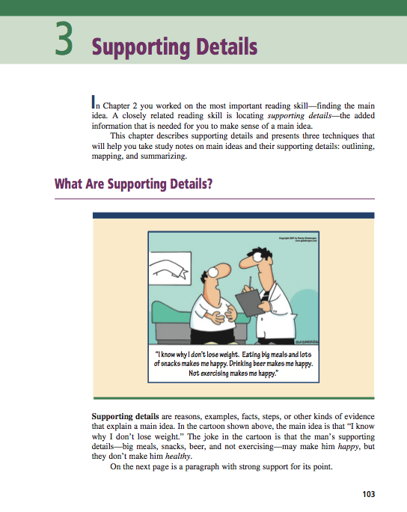
CHAPTER 2 Main Ideas
Recognizing the Main Idea
/ 2 Use the Topic to Lead You to the Main Idea
Textbook authors use the title of each chapter to state the overall topic of that chapter.
They also provide many topics and subtopics in boldface headings within the chapter.
Notes:
See page 63 in textbook

Slide 25
CHAPTER 2 Main Ideas
Recognizing the Main Idea
/ 2 Use the Topic to Lead You to the Main Idea
But there are many times when you are not given topics—with standardized reading tests, for example,
or with individual paragraphs in articles or textbooks.
To find the topic of a selection when the topic is not given, ask this simple question:
Who or what is the selection about?
Notes:
See page 63 in textbook

Slide 26
CHAPTER 2 Main Ideas
Recognizing the Main Idea
/ 2 Use the Topic to Lead You to the Main Idea
Look again at the beginning of the paragraph you saw earlier.
Many people feel that violence on television is harmless entertainment. However, we now know that TV violence does affect people in negative ways.
What is the paragraph about?
Notes:
See page 63 in textbook
ANSWER: TV violence
The next slide shows and explains the answer.

Slide 27
CHAPTER 2 Main Ideas
Recognizing the Main Idea
/ 2 Use the Topic to Lead You to the Main Idea
Many people feel that violence on television is harmless entertainment. However, we now know that TV violence does affect people in negative ways.
What is the paragraph about?
TV violence
Notes:
See page 63 in textbook

Slide 28
CHAPTER 2 Main Ideas
Recognizing the Main Idea
/ 2 Use the Topic to Lead You to the Main Idea
In fact, every sentence in the paragraph is about TV violence.
Many people feel that violence on television is harmless entertainment. However, we now know that TV violence does affect people in negative ways. One study showed that frequent TV watchers are more fearful and suspicious of others. They try to protect
themselves from the outside world with extra locks on the doors, alarm systems, guard dogs, and guns. In addition, that same study showed that heavy TV watchers are less upset about real-life violence than non-TV watchers. It seems that the constant violence they see on TV makes them less sensitive to the real thing. Another study, of a group of children, found that TV violence increases aggressive behavior. Children who watched violent shows were more willing to hurt another child in games where they were given a choice between helping and hurting. They were also more likely to select toy weapons over other kinds of playthings.
In addition, words like violence and TV are used repeatedly throughout the paragraph.
Notes:
See page 63 in textbook

Slide 29
CHAPTER 2 Main Ideas
Recognizing the Main Idea
/ 2 Use the Topic to Lead You to the Main Idea
The next step after finding the topic is to decide what
main point the author is making about the topic.
Many people feel that violence on television is harmless entertainment. However, we now know that TV violence does affect people in negative ways. One study showed that frequent TV watchers are more fearful and suspicious of others. They try to protect
themselves from the outside world with extra locks on the doors, alarm systems, guard dogs, and guns. In addition, that same study showed that heavy TV watchers are less upset about real-life violence than non-TV watchers. It seems that the constant violence they see on TV makes them less sensitive to the real thing. Another study, of a group of children, found that TV violence increases aggressive behavior. Children who watched violent shows were more willing to hurt another child in games where they were given a choice between helping and hurting. They were also more likely to select toy weapons over other kinds of playthings.
Notes:
See page 63 in textbook

Slide 30
CHAPTER 2 Main Ideas
Recognizing the Main Idea
/ 2 Use the Topic to Lead You to the Main Idea
Authors often present their main idea in a single sentence.
This sentence is known as the main idea sentence or
the topic sentence.
Many people feel that violence on television is harmless entertainment. However, we now know that TV violence does affect people in negative ways. One study showed that frequent TV watchers are more fearful and suspicious of others. They try to protect
themselves from the outside world with extra locks on the doors, alarm systems, guard dogs, and guns. In addition, that same study showed that heavy TV watchers are less upset about real-life violence than non-TV watchers. It seems that the constant violence they see on TV makes them less sensitive to the real thing. Another study, of a group of children, found that TV violence increases aggressive behavior. Children who watched violent shows were more willing to hurt another child in games where they were given a choice between helping and hurting. They were also more likely to select toy weapons over other kinds of playthings.
Notes:
See page 63 in textbook

Slide 31
CHAPTER 2 Main Ideas
Recognizing the Main Idea
/ 2 Use the Topic to Lead You to the Main Idea
Read this paragraph and decide what the topic is.
Recently a family of four was found dead in a suburban home in New Jersey—victims
of carbon monoxide. Such cases are tragically common. Carbon monoxide is deadly for many reasons. To begin with, it is created in the most ordinary of ways—by the burning of wood, coal, or petroleum products. Once created, this gas is impossible to detect without
instruments: it is colorless, odorless, and tasteless. Also, carbon monoxide mingles with and remains in the air rather than rising and being carried away by the wind. Then, when people unsuspectingly breathe it in, it chokes them, taking the place of the oxygen in their blood. Furthermore, it can do its lethal work in very small quantities: anyone exposed to air that is just 1 percent carbon monoxide for even a few minutes will almost certainly die.
What is the topic?
Notes:
See page 64 in textbook
ANSWER: Carbon monoxide
The next slide shows and explains the answer.

Slide 32
CHAPTER 2 Main Ideas
Recognizing the Main Idea
/ 2 Use the Topic to Lead You to the Main Idea
Recently a family of four was found dead in a suburban home in New Jersey—victims
of carbon monoxide. Such cases are tragically common. Carbon monoxide is deadly for many reasons. To begin with, it is created in the most ordinary of ways—by the burning of wood, coal, or petroleum products. Once created, this gas is impossible to detect without
instruments: it is colorless, odorless, and tasteless. Also, carbon monoxide mingles with and remains in the air rather than rising and being carried away by the wind. Then, when people unsuspectingly breathe it in, it chokes them, taking the place of the oxygen in their blood. Furthermore, it can do its lethal work in very small quantities: anyone exposed to air that is just 1 percent carbon monoxide for even a few minutes will almost certainly die.
What is the topic?
Carbon monoxide
As the first sentence of the paragraph suggests, the topic is “carbon monoxide.” Reading the paragraph, you see that, in fact, everything in it is about carbon monoxide. Notice how many times carbon monoxide is referred to.
Notes:
See page 64 in textbook

Slide 33
CHAPTER 2 Main Ideas
Recognizing the Main Idea
/ 2 Use the Topic to Lead You to the Main Idea
Recently a family of four was found dead in a suburban home in New Jersey—victims
of carbon monoxide. Such cases are tragically common. Carbon monoxide is deadly for many reasons. To begin with, it is created in the most ordinary of ways—by the burning of wood, coal, or petroleum products. Once created, this gas is impossible to detect without
instruments: it is colorless, odorless, and tasteless. Also, carbon monoxide mingles with and remains in the air rather than rising and being carried away by the wind. Then, when people unsuspectingly breathe it in, it chokes them, taking the place of the oxygen in their blood. Furthermore, it can do its lethal work in very small quantities: anyone exposed to air that is just 1 percent carbon monoxide for even a few minutes will almost certainly die.
What is the main idea of this paragraph?
Notes:
See page 64 in textbook
ANSWER: Carbon monoxide is deadly for many reasons.
The next slide shows and explains the answer.

Slide 34
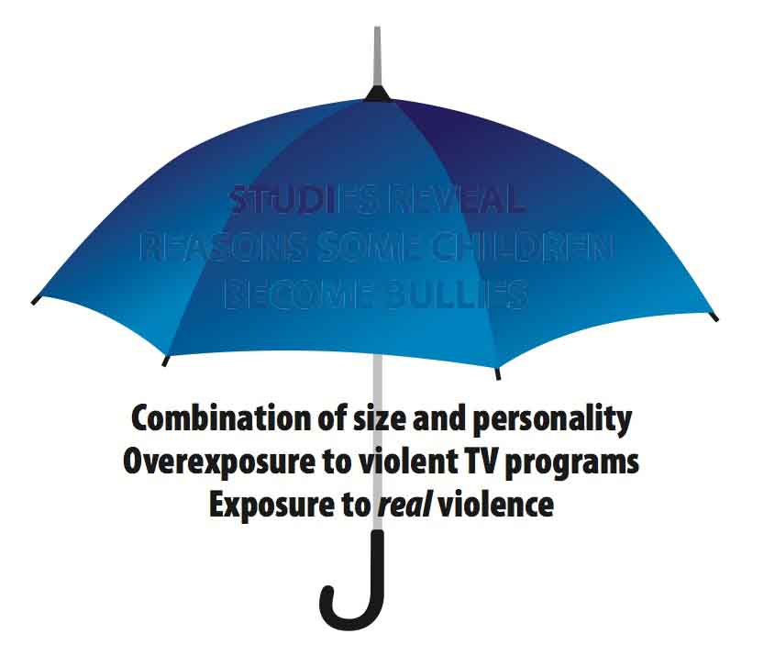
CHAPTER 2 Main Ideas
Recognizing the Main Idea
/ 2 Use the Topic to Lead You to the Main Idea
Main Idea
Recently a family of four was found dead in a suburban home in New Jersey—victims
of carbon monoxide. Such cases are tragically common. Carbon monoxide is deadly for many reasons. To begin with, it is created in the most ordinary of ways—by the burning of wood, coal, or petroleum products. Once created, this gas is impossible to detect without
instruments: it is colorless, odorless, and tasteless. Also, carbon monoxide mingles with and remains in the air rather than rising and being carried away by the wind. Then, when people unsuspectingly breathe it in, it chokes them, taking the place of the oxygen in their blood. Furthermore, it can do its lethal work in very small quantities: anyone exposed to air that is just 1 percent carbon monoxide for even a few minutes will almost certainly die.
What is the main idea of this paragraph?
Carbon monoxide is deadly for many reasons.
This idea is a general one that sums up what the entire paragraph
is about. It is an “umbrella” statement under which all the other material in the paragraph fits.
Notes:
See page 64 in textbook

Slide 35
CHAPTER 2 Main Ideas
Recognizing the Main Idea
/ 2 Use the Topic to Lead You to the Main Idea
Recently a family of four was found dead in a suburban home in New Jersey—victims
of carbon monoxide. Such cases are tragically common. Carbon monoxide is deadly for many reasons. To begin with, it is created in the most ordinary of ways—by the burning of wood, coal, or petroleum products. Once created, this gas is impossible to detect without
instruments: it is colorless, odorless, and tasteless. Also, carbon monoxide mingles with and remains in the air rather than rising and being carried away by the wind. Then, when people unsuspectingly breathe it in, it chokes them, taking the place of the oxygen in their blood. Furthermore, it can do its lethal work in very small quantities: anyone exposed to air that is just 1 percent carbon monoxide for even a few minutes will almost certainly die.
The parts of the paragraph could be shown as follows:
Topic: Carbon monoxide
Main idea: Carbon monoxide is deadly for many reasons.
Supporting details: 1. Is easily created
2. Is difficult to detect
3. Remains in the air
4. Chokes by taking the place of oxygen in the blood
5. Deadly even in small quantities
Notes:
See page 64 in textbook

Slide 36
CHAPTER 2 Main Ideas
Recognizing the Main Idea
As you read a paragraph, remember to ask yourself
these key questions:
1
Ask yourself, “What seems to be the topic of the paragraph?”
2
Next, ask yourself, “What point is the writer making about this topic?” This will be the main idea.
3
Then test what you think is the main idea by asking, “Is this statement supported by most of the other material in the paragraph?”
Notes:
See page 66 in textbook

Slide 37
CHAPTER 2 Main Ideas
Recognizing the Main Idea
3 Find and Use Key Words to Lead You to the Main Idea
Sometimes authors make it fairly easy to find their main idea.
They announce it by using key words—verbal clues that are easy to recognize.
Notes:
See page 69 in textbook

Slide 38
CHAPTER 2 Main Ideas
Recognizing the Main Idea
/ 3 Use Key Words to Lead You to the Main Idea
One group of key words is list words, which tell you a list of items is to follow.
The main idea in the paragraph about TV violence was stated like this:
However, we now know that TV violence does affect people in negative ways.
The expression negative ways helps you zero in on your target: the main idea.
Notes:
See page 69 in textbook

Slide 39
CHAPTER 2 Main Ideas
Recognizing the Main Idea
/ 3 Use Key Words to Lead You to the Main Idea
Here are some common word groups that often announce
a main idea:
List Words
Note that each of them contains a word that ends in s—a plural that suggests the supporting details will be a list of items.
Notes:
See page 69 in textbook

Slide 40
CHAPTER 2 Main Ideas
Recognizing the Main Idea
/ 3 Use Key Words to Lead You to the Main Idea
List Words
Many other list-word expressions are possible—“four kinds of,” “some advantages of, ” or “three reasons for.” So if you see a sentence with a word group like the ones above, you’ve probably found the main idea.
Notes:
See page 69 in textbook

Slide 41
CHAPTER 2 Main Ideas
Recognizing the Main Idea
/ 3 Use Key Words to Lead You to the Main Idea
What are the list words in each of the sentences below?
1. At least five job trends deserve watching in today’s world.
2. Pathologists identify four different stages of cancer in the body.
3. Winners of presidential elections share various traits in common.
Notes:
See page 69 in textbook
ANSWER: 1. five job trends; 2. four different stages; 3. various traits
The next slide shows and explains the answer.

Slide 42
CHAPTER 2 Main Ideas
Recognizing the Main Idea
/ 3 Use Key Words to Lead You to the Main Idea
What are the list words in each of the sentences below?
1. At least five job trends deserve watching in today’s world.
2. Pathologists identify four different stages of cancer in the body.
3. Winners of presidential elections share various traits in common.
Each of these phrases tells you that a list of details will follow.
Notes:
See page 69–70 in textbook

Slide 43
CHAPTER 2 Main Ideas
Recognizing the Main Idea
/ 3 Use Key Words to Lead You to the Main Idea
In addition to list words, addition words can alert you to the main idea.
Addition words are generally used right before a supporting detail.
Here are some of the addition words that often introduce supporting details and help you discover the main idea:
Addition Words
When you see this type of clue, you can assume that the detail it introduces fits under the umbrella of a main idea.
Notes:
See page 70 in textbook

Slide 44
CHAPTER 2 Main Ideas
Recognizing the Main Idea
/ 3 Use Key Words to Lead You to the Main Idea
Reread the paragraph about TV violence. As you do, pick out the addition words that alert you to supporting details. Also note
the list words that suggest the main idea.
Many people feel that violence on television is harmless entertainment. However, we now know that TV violence does affect people in negative ways. One study showed that frequent TV watchers are more fearful and suspicious of others. They try to protect
themselves from the outside world with extra locks on the doors, alarm systems, guard dogs, and guns. In addition, that same study showed that heavy TV watchers are less upset about real-life violence than non-TV watchers. It seems that the constant violence they see on TV makes them less sensitive to the real thing. Another study, of a group of children, found that TV violence increases aggressive behavior. Children who watched violent shows were more willing to hurt another child in games where they were given a choice between helping and hurting. They were also more likely to select toy weapons over other kinds of playthings.
Notes:
See page 70 in textbook
ANSWER: Addition words: One, In addition, Another; List words: negative ways
The next slide shows and explains the answer.

Slide 45
CHAPTER 2 Main Ideas
Recognizing the Main Idea
/ 3 Use Key Words to Lead You to the Main Idea
List
words
Many people feel that violence on television is harmless entertainment. However, we now know that TV violence does affect people in negative ways. One study showed that frequent TV watchers are more fearful and suspicious of others. They try to protect
themselves from the outside world with extra locks on the doors, alarm systems, guard dogs, and guns. In addition, that same study showed that heavy TV watchers are less upset about real-life violence than non-TV watchers. It seems that the constant violence they see on TV makes them less sensitive to the real thing. Another study, of a group of children, found that TV violence increases aggressive behavior. Children who watched violent shows were more willing to hurt another child in games where they were given a choice between helping and hurting. They were also more likely to select toy weapons over other kinds of playthings.
Addition word
Addition words
Addition word
Addition words introduce each new supporting detail. These addition words introduce three results of studies on TV violence.
The list words negative ways signal the supporting details will be a list of negative ways TV violence affects people.
Notes:
See page 70 in textbook

Slide 46
CHAPTER 2 Main Ideas
Locations of the Main Idea
A main idea may appear at any point within a paragraph. Very commonly, it shows up at the beginning, as either the first or the second sentence.
However, main ideas may also appear further within a paragraph or even at the very end.
Notes:
See page 71 in textbook

Slide 47
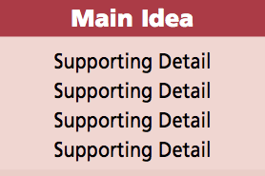
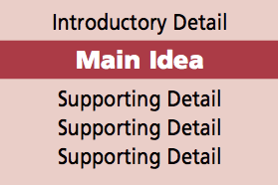
CHAPTER 2 Main Ideas
Locations of the Main Idea
Main Idea at the Beginning
OR
In textbooks, it is very common for the main idea to be either the first or the second sentence.
Notes:
See page 71 in textbook

Slide 48
CHAPTER 2 Main Ideas
Locations of the Main Idea
/ Main Idea at the Beginning
As you read the paragraph below, look for the main idea.
People tend to cling to their first impressions, even if they are wrong. Suppose you mention the name of your new neighbor to a friend. “Oh, I know him,” your friend replies. “He seems nice at first, but it’s all an act.” Perhaps this appraisal is off-base. The neighbor may have changed since your friend knew him, or perhaps your friend’s judgment is simply unfair. Whether the judgment is accurate or not, once you accept your friend’s evaluation, it will probably influence the way you respond to the neighbor. You’ll look for examples of the insincerity you’ve heard about, and you’ll probably find them. Even if this neighbor were a saint, you would be likely to interpret his behavior in ways that fit your expectations.
Which sentence contains the main idea?
Notes:
See page 72 in textbook
ANSWER: The first sentence
The next slide shows and explains the answer.

Slide 49
CHAPTER 2 Main Ideas
Locations of the Main Idea
/ Main Idea at the Beginning
Main Idea
People tend to cling to their first impressions, even if they are wrong. Suppose you mention the name of your new neighbor to a friend. “Oh, I know him,” your friend replies. “He seems nice at first, but it’s all an act.” Perhaps this appraisal is off-base. The neighbor may have changed since your friend knew him, or perhaps your friend’s judgment is simply unfair. Whether the judgment is accurate or not, once you accept your friend’s evaluation, it will probably influence the way you respond to the neighbor. You’ll look for examples of the insincerity you’ve heard about, and you’ll probably find them. Even if this neighbor were a saint, you would be likely to interpret his behavior in ways that fit your expectations.
Which sentence contains the main idea?
In this paragraph, the main idea is in the first sentence. All the following sentences in the paragraph provide a detailed example of how we cling to first impressions.
Notes:
See page 72 in textbook

Slide 50
CHAPTER 2 Main Ideas
Locations of the Main Idea
/ Main Idea at the Beginning
Read the paragraph below and see if you can pick out
the main idea.
For shy people, simply attending class can be stressful. Several strategies, though, can lessen the trauma of attending class for shy people. Shy students should time their arrival to coincide with that of most other class members—about two minutes before the class is scheduled to begin. If they arrive too early, they may be seen sitting alone or, even worse, may actually be forced to talk with another early arrival. If they arrive late, all eyes will be upon them. Before heading to class, shy students should dress in the least conspicuous manner possible—say, in the blue jeans, sweatshirt, and sneakers that 99.9 percent of their classmates wear. That way they won’t stand out from everyone else. They should take a seat near the
back of the room. But they shouldn’t sit at the very back, since instructors sometimes make a point of calling on students there.
Which sentence contains the main idea?
Notes:
See page 72 in textbook
ANSWER: The second sentence
The next slide shows and explains the answer.

Slide 51
CHAPTER 2 Main Ideas
Locations of the Main Idea
/ Main Idea at the Beginning
Main idea
For shy people, simply attending class can be stressful. Several strategies, though, can lessen the trauma of attending class for shy people. Shy students should time their arrival to coincide with that of most other class members—about two minutes before the class is scheduled to begin. If they arrive too early, they may be seen sitting alone or, even worse, may actually be forced to talk with another early arrival. If they arrive late, all eyes will be upon them. Before heading to class, shy students should dress in the least conspicuous manner possible—say, in the blue jeans, sweatshirt, and sneakers that 99.9 percent of their classmates wear. That way they won’t stand out from everyone else. They should take a seat near the
back of the room. But they shouldn’t sit at the very back, since instructors sometimes make a point of calling on students there.
Intro detail
Support
The first sentence introduces the topic: shy people in class.
The second sentence contains the main idea.
The remaining sentences support the main idea that several strategies can lessen the trauma of attending class for shy people.
Notes:
See page 72 in textbook

Slide 52
CHAPTER 2 Main Ideas
Locations of the Main Idea
/ Main Idea at the Beginning
For shy people, simply attending class can be stressful. Several strategies, though, can lessen the trauma of attending class for shy people. Shy students should time their arrival to coincide with that of most other class members—about two minutes before the class is scheduled to begin. If they arrive too early, they may be seen sitting alone or, even worse, may actually be forced to talk with another early arrival. If they arrive late, all eyes will be upon them. Before heading to class, shy students should dress in the least conspicuous manner possible—say, in the blue jeans, sweatshirt, and sneakers that 99.9 percent of their classmates wear. That way they won’t stand out from everyone else. They should take a seat near the
back of the room. But they shouldn’t sit at the very back, since instructors sometimes make a point of calling on students there.
though
Very often, a contrast word like however, but, yet, or though signals the main idea, as in this paragraph.
Notes:
See page 72 in textbook

Slide 53
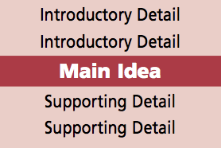
CHAPTER 2 Main Ideas
Locations of the Main Idea
Main Idea in the Middle
The main idea at times appears in the middle of a paragraph.
Notes:
See page 73 in textbook

Slide 54
CHAPTER 2 Main Ideas
Locations of the Main Idea
/ Main Idea in the MIddle
Read the paragraph below and try to find the main idea.
A television ad for a new sports car showed scenes of beautiful open country that suggested freedom and adventure. The car never appeared in the ad at all. An ad for a hotel chain showed a romantic couple in bed together. They were obviously on vacation and having a leisurely, romantic, sexy morning. As these ads suggest, advertisers often try to sell products and services by associating them with positive images rather than by providing relevant
details about the product or service. An ad giving the car’s gas mileage, safety rating, or repair frequency would be more important to a buyer, but it might not draw the viewer’s interest as much as beautiful scenery. Similarly, details on the hotel’s prices and service would be more informative than images of a glamorous vacation. But the romantic couple gets people’s attention and associates the hotel in viewers’ minds with a good time.
Which sentence contains the main idea?
Notes:
See page 73 in textbook
ANSWER: The fifth sentence
The next slide shows and explains the answer.

Slide 55
CHAPTER 2 Main Ideas
Locations of the Main Idea
/ Main Idea in the MIddle
A television ad for a new sports car showed scenes of beautiful open country that suggested freedom and adventure. The car never appeared in the ad at all. An ad for a hotel chain showed a romantic couple in bed together. They were obviously on vacation and having a leisurely, romantic, sexy morning. As these ads suggest, advertisers often try to sell products and services by associating them with positive images rather than by providing relevant
details about the product or service. An ad giving the car’s gas mileage, safety rating, or repair frequency would be more important to a buyer, but it might not draw the viewer’s interest as much as beautiful scenery. Similarly, details on the hotel’s prices and service would be more informative than images of a glamorous vacation. But the romantic couple gets people’s attention and associates the hotel in viewers’ minds with a good time.
Intro
of
topic,
exmpls
Main idea
Support
The first four sentences introduce the topic of advertisers and provide specific examples of the main idea.
The fifth sentence then presents the main idea—that advertisers often try to sell their products by associating them with appealing images rather than with relevant details.
The rest of the paragraph continues to develop the main idea.
Notes:
See page 73 in textbook

Slide 56
CHAPTER 2 Main Ideas
Locations of the Main Idea
Main Idea at the End
Sometimes all the sentences in a paragraph will lead up to the main idea, which is presented at the end.
Notes:
See page 73 in textbook

Slide 57
CHAPTER 2 Main Ideas
Locations of the Main Idea
/ Main Idea at the End
Here is a paragraph with the main idea at the end.
At the end of the twentieth century, with the economy booming and unemployment at historic lows, the American economy was a job-producing marvel. Opportunities for workers seemed endless; college students were getting bonuses from companies before they started working, and older workers were planning early retirement. The first decade of the twenty-
first century was entirely different. From the 9/11 terrorist attacks to surges in oil prices to bank failures and financial losses on Wall Street and in the housing market, millions either lost their jobs or feared they would. They watched helplessly as the value of their houses and retirement savings declined. At the end of the first decade of the twenty-first century, the United States endured the Great Recession, the worst economy in seventy years. In less than a decade, Americans experienced the best and worst of times.
Notes:
See page 74 in textbook

Slide 58
CHAPTER 2 Main Ideas
Locations of the Main Idea
/ Main Idea at the End
At the end of the twentieth century, with the economy booming and unemployment at historic lows, the American economy was a job-producing marvel. Opportunities for workers seemed endless; college students were getting bonuses from companies before they started working, and older workers were planning early retirement. The first decade of the twenty-
first century was entirely different. From the 9/11 terrorist attacks to surges in oil prices to bank failures and financial losses on Wall Street and in the housing market, millions either lost their jobs or feared they would. They watched helplessly as the value of their houses and retirement savings declined. At the end of the first decade of the twenty-first century, the United States endured the Great Recession, the worst economy in seventy years. In less than a decade, Americans experienced the best and worst of times.
Main idea
Notes:
See page 74 in textbook

Slide 59
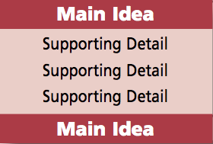
CHAPTER 2 Main Ideas
Locations of the Main Idea
Main Idea at the Beginning and the End
At times an author may choose to state the main idea
near the beginning of the paragraph and then emphasize
it (as a conclusion) by restating it later in the paragraph.
Notes:
See page 74 in textbook

Slide 60
CHAPTER 2 Main Ideas
Locations of the Main Idea
/ Main Idea at the Beginning and the End
Here is a paragraph with the main idea at the beginning and the end.
An important result of medical advances is an increase in the number of conditions thought to be of medical concern. In the not-too-distant past, birth and death usually occurred at home. Family members and friends were there or close by. Now most people are born and die in a hospital, surrounded by bright lights and expensive machines. People who were addicted to alcohol or drugs were once considered sinful or lacking in willpower. Now they are considered “sick.” Problems that used to be accepted as part of life—baldness, wrinkles, small breasts, sleeplessness—are now deemed proper matters for medical attention. Some criminologists have even defined antisocial behavior as a medical problem. Lawbreakers of all kinds, from the shoplifter to the mass murderer, may potentially be labeled “sick.” Because of current medical knowledge, what were once thought to be problems of life or of character are now considered medical issues.
Notes:
See page 74 in textbook

Slide 61
CHAPTER 2 Main Ideas
Locations of the Main Idea
/ Main Idea at the Beginning and the End
Main idea
An important result of medical advances is an increase in the number of conditions thought to be of medical concern. In the not-too-distant past, birth and death usually occurred at home. Family members and friends were there or close by. Now most people are born and die in a hospital, surrounded by bright lights and expensive machines. People who were addicted to alcohol or drugs were once considered sinful or lacking in willpower. Now they are considered “sick.” Problems that used to be accepted as part of life—baldness, wrinkles, small breasts, sleeplessness—are now deemed proper matters for medical attention. Some criminologists have even defined antisocial behavior as a medical problem. Lawbreakers of all kinds, from the shoplifter to the mass murderer, may potentially be labeled “sick.” Because of current medical knowledge, what were once thought to be problems of life or of character are now considered medical issues.
Main idea
Note that the main idea—because of medical advances, more problems are considered medical issues—is expressed in different words in the first and last sentences.
Notes:
See page 74 in textbook

Slide 62
CHAPTER 2 Main Ideas
Locations of the Main Idea
The Central Point
Just as a paragraph may have a main idea, a longer selection may have a central point, also known as a central idea or thesis.
You can find a central point in the same way that you find a main idea—by identifying the topic (which is often suggested by the title of the selection) and then looking at the supporting material.
The paragraphs within the longer reading will provide supporting details for the central point.
Notes:
See page 76 in textbook

Slide 63
CHAPTER 2 Main Ideas
Locations of the Main Idea
/ The Central Point
For practice finding the central point in longer selections, see pages 77–78 in the textbook.
Notes:
See page 77–78 in textbook

Slide 64
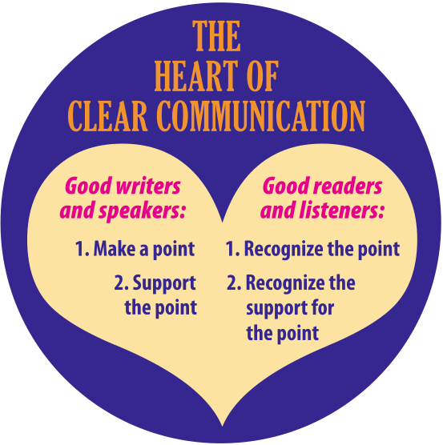
CHAPTER 2 Main Ideas
Locations of the Main Idea
A Final Thought
Whether we are readers, writers, listeners, or speakers, the “heart” of clear communication is the main idea, or point, and the support for the main idea.
Notes:
See page 79 in textbook

Slide 65
CHAPTER 2 Main Ideas
Chapter Review
In this chapter, you learned the following:
Recognizing the main idea is the most important key to good comprehension. The main idea is a general “umbrella” idea; all the specific supporting material of the passage fits under it.
Three strategies that will help you find the main idea are to
1) look for general versus specific ideas; 2) use the topic (the
general subject of a selection) to lead you to the main idea;
3) use key words—verbal clues that lead you to the main idea.
The main idea often appears at the beginning of a paragraph, though it may appear elsewhere in a paragraph.
The next chapter—Chapter 3—will sharpen your understanding of the specific details that authors use to support and develop their main ideas.
Notes:
See page 80 in textbook

